Slide 1

SEPTIEMBRE 24 - 28, CDMX
Ciudad Universitaria
FRONTERAS DEL CONOCIMIENTO. MUSEOS, DOCUMENTACIÓN Y DATOS ENLAZADOS
FRONTIERS OF KNOWLEDGE. MUSEUMS, DOCUMENTATION AND LINKED DATA

Slide 2


Intersections Between Linked Art and Spectrum
Henrique Godinho & Vânia Mara Alves Lima (Advisor)
The Ema Klabin House Musem & Professional master's student in Information Management, specializing in the Organization, Mediation, and Circulation of Information within the Graduate Program in Information Science at the School of Communications and Arts at the University of São Paulo.

Slide 3

Mdorim
Modelo de Dados para Organização e Representação da Informação Museológica
Data Model for Organization and Representation of Museum Information

Slide 4
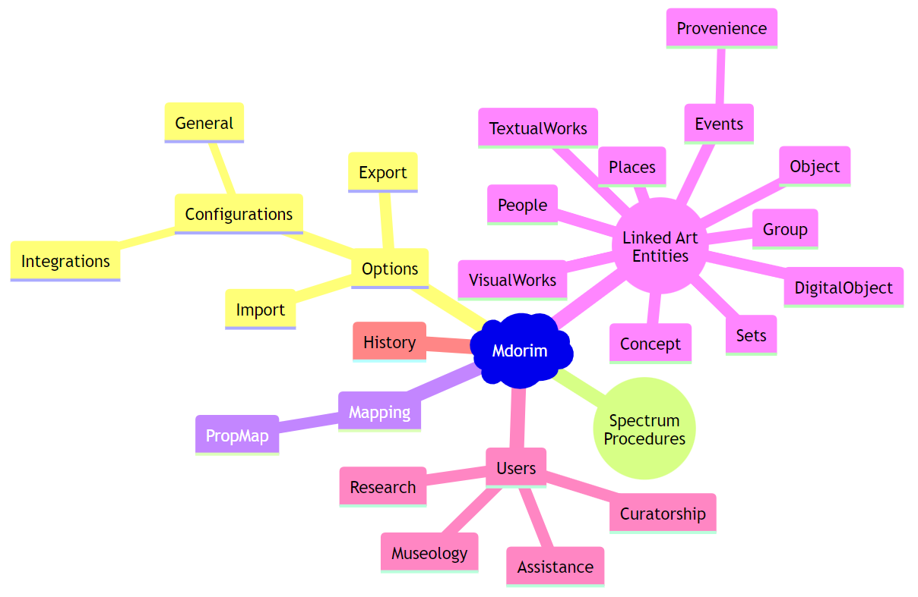
Mdorim mind-map
Developed by the authors

Slide 5
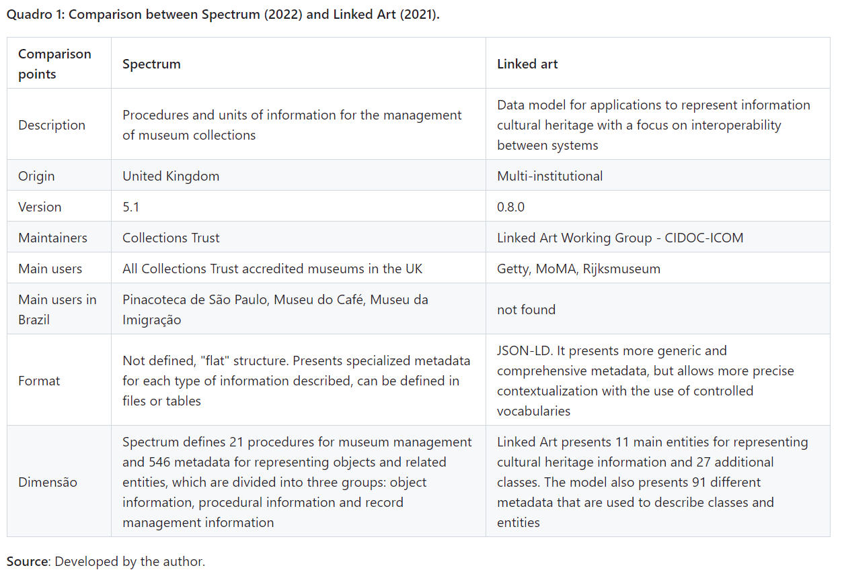

Slide 6

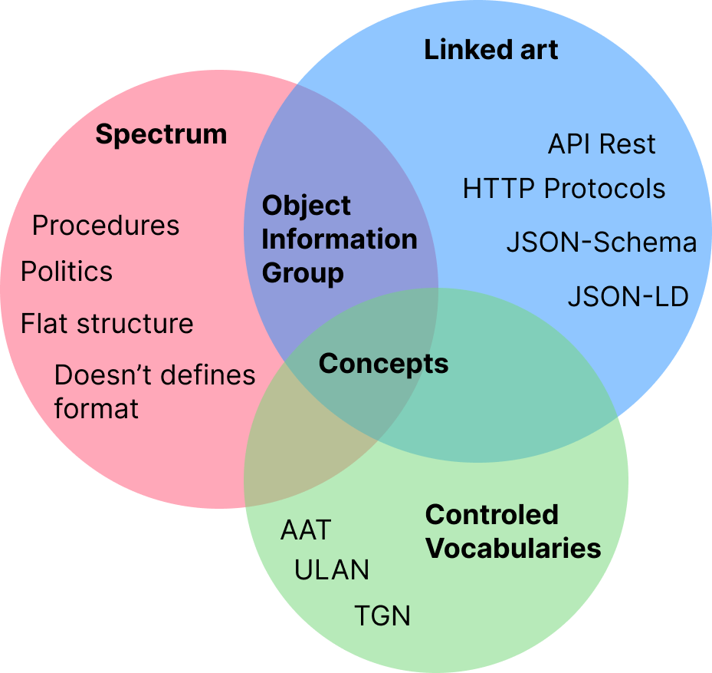
Intersections

Slide 7
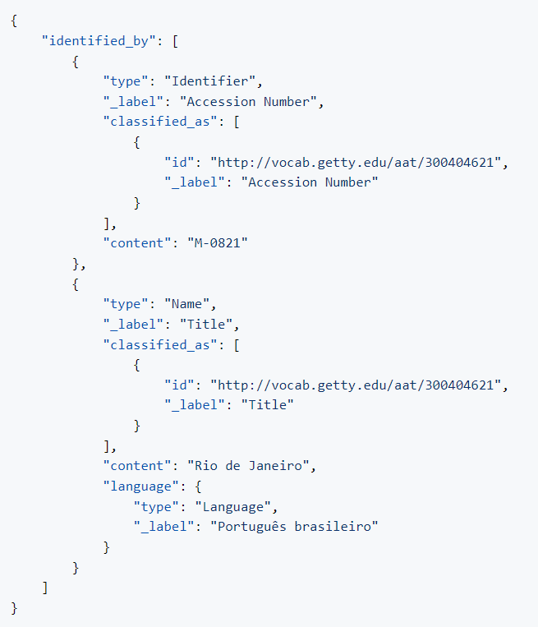
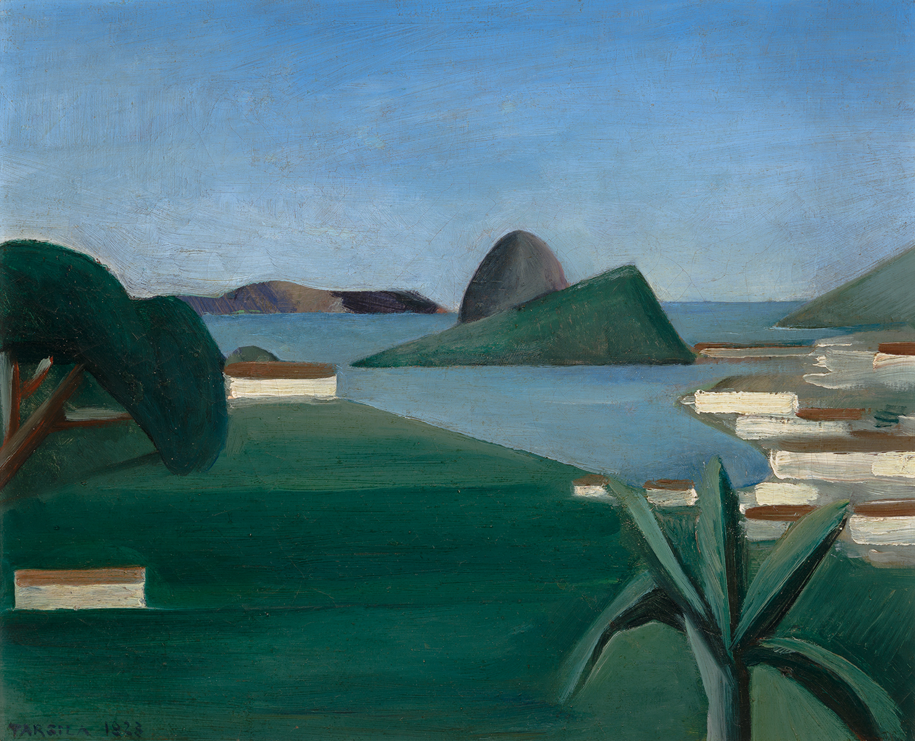
Identification of an object, demonstrates the identified_by property with an array of Identifier and Name objects and their classified_as properties in Linked Art.

Slide 8
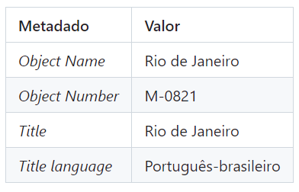
Identification of the same object in Spectrum

Slide 9

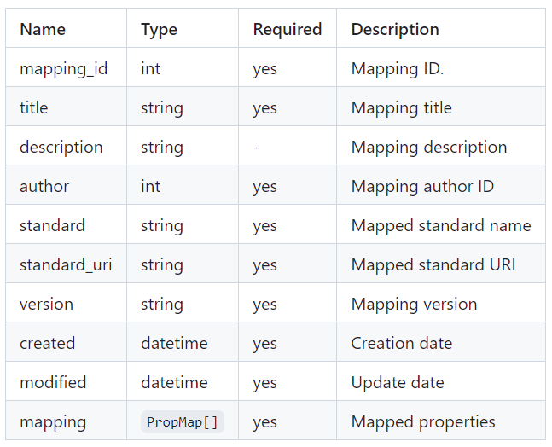
Mapping entity

Slide 10
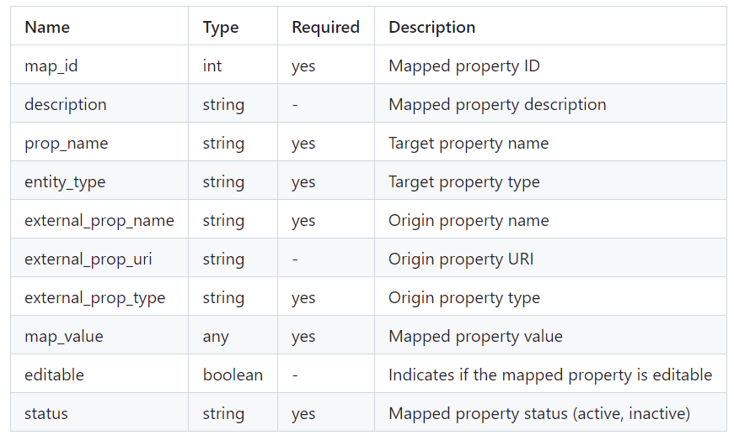
PropMap entity

Slide 11
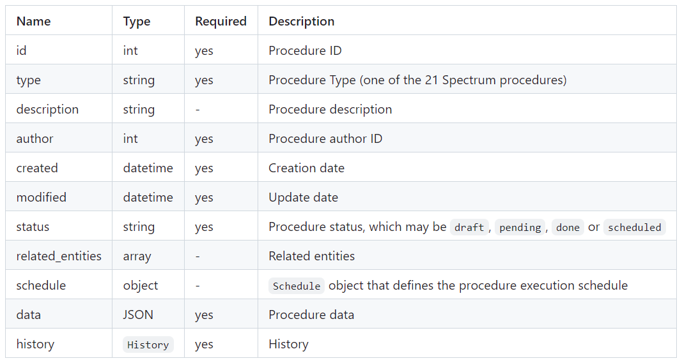
Procedure entity

Slide 12

Título Title
DUIS VULPUTATE ENIM AT SAPIEN FRINGILLA EUISMOD.
QUISQUE MOLESTIE VENENATIS VIVERRA.
SUSPENDISSE FAUCIBUS NISI AC DAPIBUS PULVINAR.
Nunc interdum mattis ante sit amet condimentum. Duis metus nulla, condimentum eu semper non, molestie a elit.
Nam faucibus consectetur nibh, et malesuada eros convallis ut. Vivamus fermentum erat ut placerat ultricies.
Donec nulla erat, ullamcorper eu elementum id, placerat feugiat nisi.

Slide 13
How to download and install the Monserrat font?
Resources page
DOWNLOAD HERE:
HTTPS://FONTS.GOOGLE.COM/DOWNLOAD?FAMILY=MONTSERRAT
For install:
1. Double click on the files
2. A font preview window will open. In the upper left part you will find the button ‹‹Install››, click it.
In MacOS operating systems, you will find the button in the lower right part.
3. The font will be installed in the operating system.
For its use, from the interface of the program, it resorts to the previously listed nomenclature.
Download the font here. Have a good time designing!

